Slide 1
Outline
Describing the fundamentals of distributed systems
Defining blockchain technology
Understanding how blockchain technology was developed
Detailing the elements of a blockchain
Identifying the benefits and limitations of blockchain technology

Slide 2
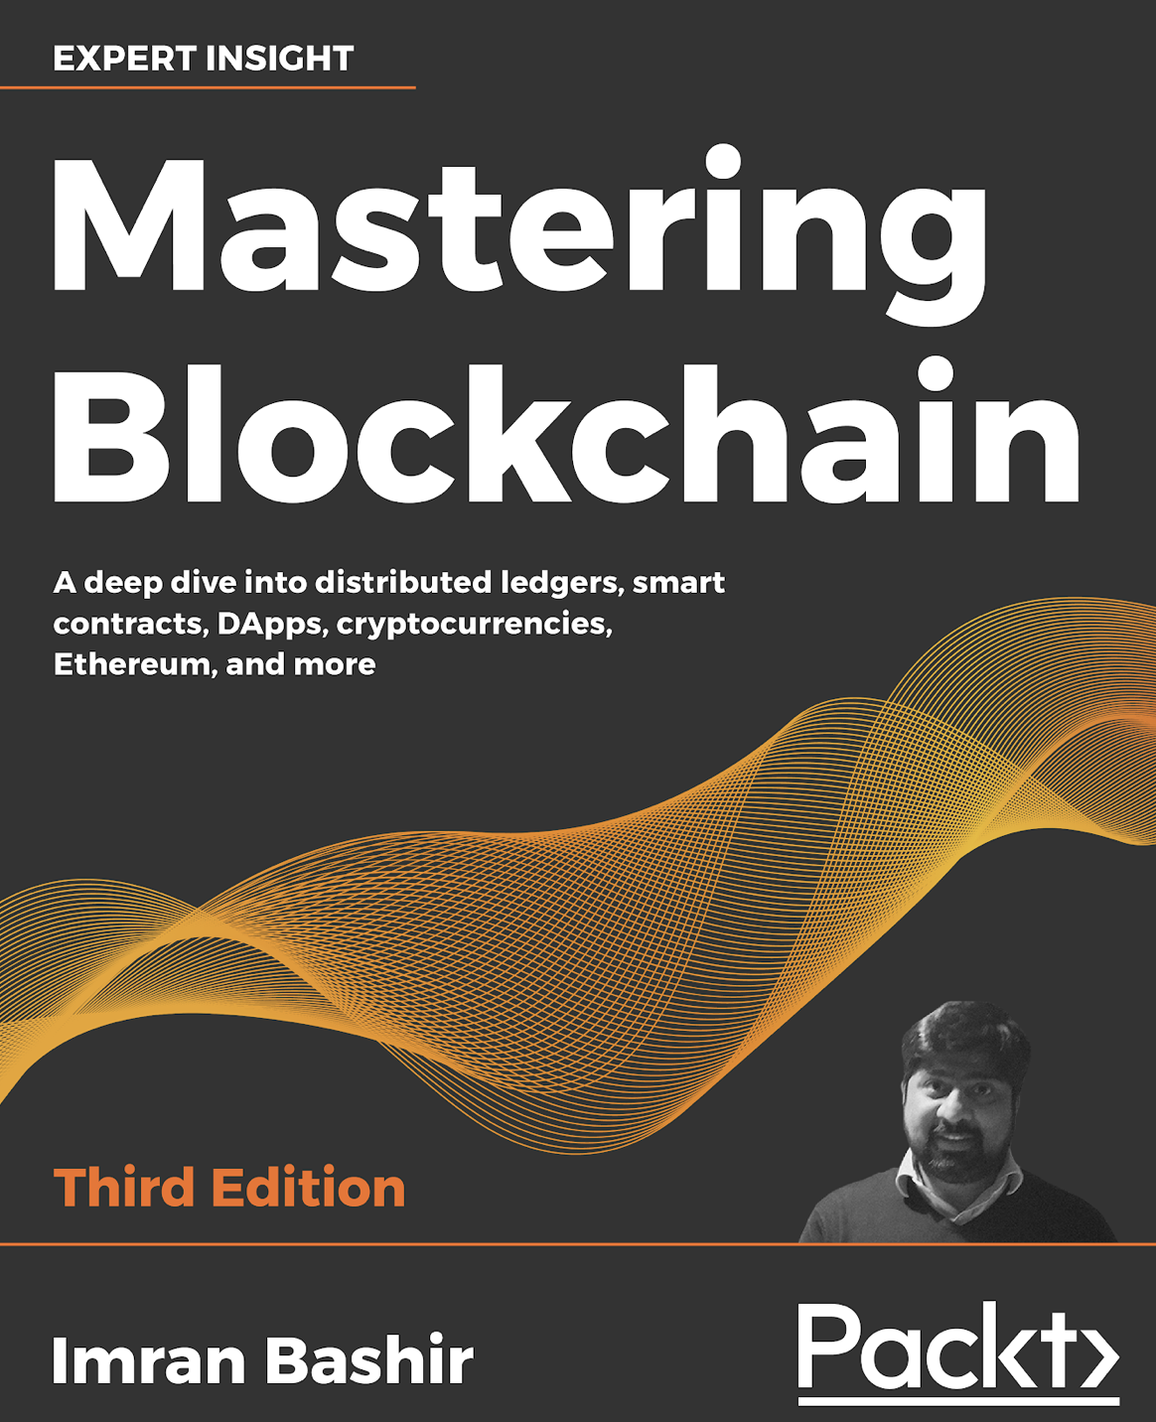
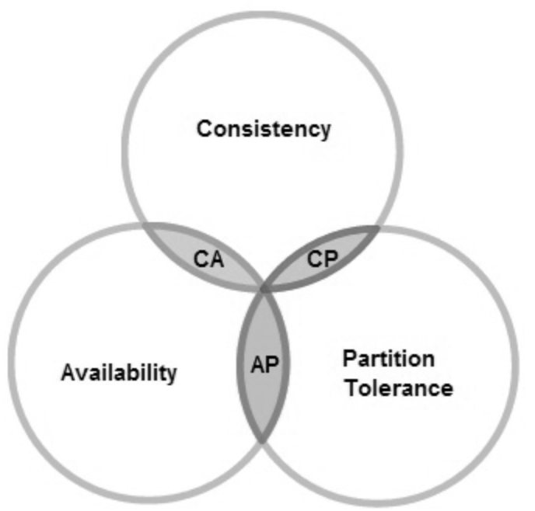
Introduction
Blockchain is a new revolutionary technology that will change our lives. In this chapter we will cover the theory of blockchain technology, and its technical foundations.

Slide 3
Introducing distributed computing
A distributed system is a computing paradigm whereby two or more nodes work with one another, in a coordinated fashion, to achieve a common outcome.
A distributed system is modeled in such a way that end users see it as a single logical platform.
Examples include clusters and clouds.

Slide 4
The Byzantine Generals problem
Attack?
5
?
Attack
Retreat
?
Retreat
?
Attack
?
Attack or retreat?
Consensus required to win

Slide 5
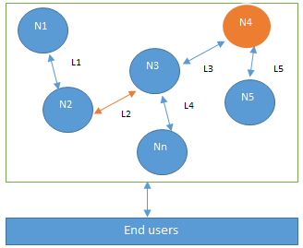
Design of a distributed system
N4 is a Byzantine node, L2 is broken or a slow network link

Slide 6
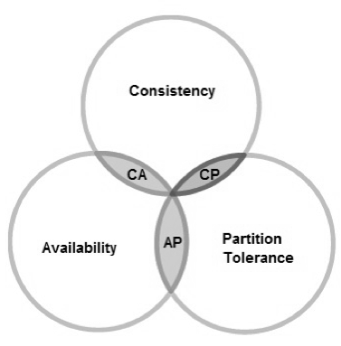
CAP theorem
This states that a distributed system cannot have all three of the desired properties simultaneously; that is:
Consistency
Availability
Partition tolerance

Slide 7
Types of faults in distributed systems
Fail-stop faults (crash faults)
Where components crash or cease to operate
Simpler to deal with
Byzantine faults
Where components are potentially untrustworthy or malicious
Difficult to deal with

Slide 8
Defining ‘Blockchain’
Layman's definition: Blockchain is an ever-growing, secure, shared recordkeeping system in which each user of the data holds a copy of the records, which can only be updated if all parties involved in a transaction agree to update.
Technical definition: Blockchain is a peer-to-peer distributed ledger that is cryptographically-secure, append-only, immutable (extremely hard to change), and updateable only via consensus or agreement among peers.

Slide 9
Blockchain definition
Peer-to-peer
Distributed ledger
Cryptographically secure
Append only
Updateable via consensus (consensus-driven)

Slide 10
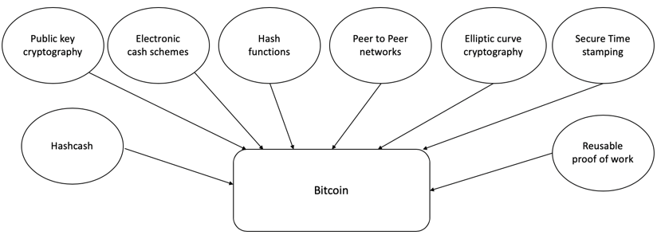
How did blockchain technology develop?
1950s – Hash functions
1970s – Merkle trees - hashes in a tree structure
1970s continued – Research in distributed systems, consensus, state machine replication
1980s – Hash chains for secure logins
1990s – e-Cash for e-payments
1991 – Secure timestamping of digital documents.
1992 – Hashcash idea to combat junk emails
1994 – S/KEY application for Unix login.
1997/2002 – Hashcash
2008/2009 – Bitcoin (the first blockchain)

Slide 11
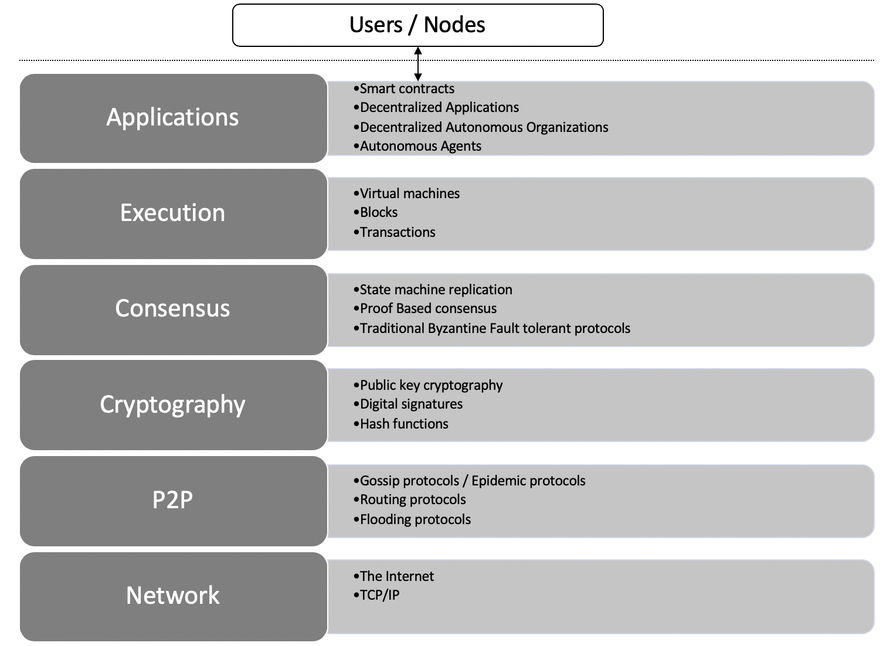
Architectural view of Blockchain

Slide 12
Generic structure of a blockchain
Genesis block
Transactions & other data
Previous hash
Block 1
Transactions & other data
Previous hash
Block 2
Transactions & other data
Previous hash
Block N
Transactions & other data
. . . . .

Slide 13
Generic elements of a blockchain
Addresses
Accounts
Transactions
Blocks
Peer-to-peer network
Scripting or programming language
Virtual machine
State machine
Nodes
Smart contracts

Slide 14








How a blockchain works
1. User X transacts with User Y
2. Transaction broadcast
3. Find new block (mining)
4. New block found (mined)
Smart contract or transfer of value
5. Add new block to the blockchain

Slide 15
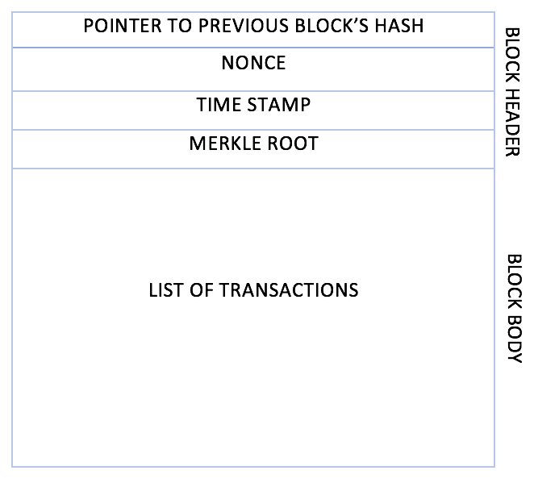
Generic block structure

Slide 16
Benefits of blockchain
Decentralization
Transparency
Trust
Immutability
High availability
Highly secure
Simplification of current paradigms
Faster transactions
Cost saving

Slide 17
Limitations of blockchain
Scalability
Adaptability
Regulation
Relatively immature technology
Privacy

Slide 18
Features of a blockchain
Distributed consensus
Transaction verification
Platform for smart contracts
Transferring value between peers
Generation of cryptocurrency
Provider of security
Immutability
Uniqueness

Slide 19
Exercise
Think about a scenario where blockchain can solve a challenge at your place of work or education, or in your community.
Read the Bitcoin paper at https://bitcoin.org/bitcoin.pdf

Slide 20
Summary
In this presentation, we:
Covered the design of a distributed system and faults in distributed systems.
Defined blockchain as a distributed ledger—a replicated digital ledger which is immutable and updateable only via consensus.
Introduced precursors to blockchain technology such as hash functions, consensus mechanisms, Hashcash, and e-cash schemes.
Explored various elements of a blockchain, such as addresses, peer-to-peer networks, blocks, and transactions.
Considered the benefits and limitations of blockchain technology.

